Slide 1
OR Gate
A | B | X = A+B
1 | 1 | 1
1 | 0 | 1
0 | 1 | 1
0 | 0 | 0

Slide 2
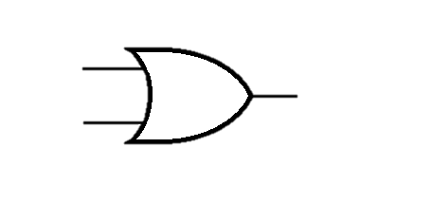
OR Gate
1
0
0
1
1
1
0
1
0
0
1
1

Slide 3
And Gate
A | B | X = A.B
1 | 1 | 1
1 | 0 | 0
0 | 1 | 0
0 | 0 | 0

Slide 4
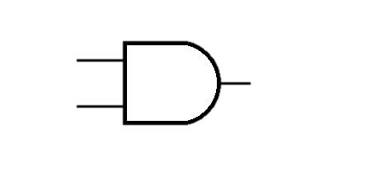
And Gate
0
1
1
0
0
1
0
0
0
1
0
1

Slide 5
XOR Gate
A | B | X = A + B
1 | 1 | 0
1 | 0 | 1
0 | 1 | 1
0 | 0 | 0

Slide 6

XOR Gate
1
1
0
0
0
1
0
1
0
0
1
1

